Slide 1
The Profession
of
Horticultural Therapy

Slide 2
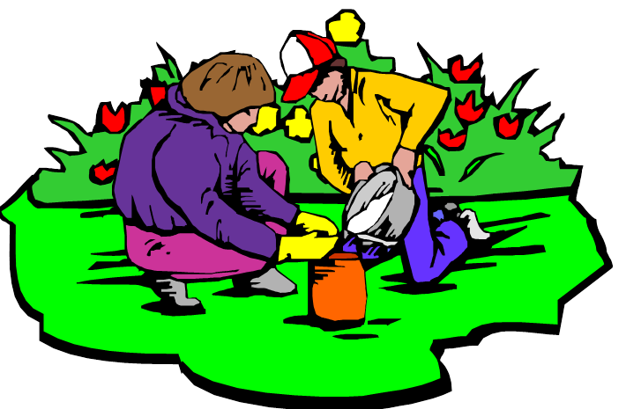
Horticultural Therapy
The participation in horticultural activities that are facilitated by a registered horticultural therapist to achieve goals within a treatment, rehabilitation, or vocational plan.

Slide 3
A Brief History
1813 – Friends Hospital, the first psychiatric hospital, prescribed horticultural therapy for treatment.
1919 – Dr. Carl Menninger, the Menninger Clinic, established the first horticultural therapist position.
1930 – horticultural therapy programs where brought into hospitals as part of occupational therapy.
1950 – after WWII, horticulture therapy programs gained recognition in veteran’s hospitals.

Slide 4
1955 – Michigan State University awarded the first Master of Science degree in Horticultural Therapy.
1960 – the first textbook in horticultural therapy, Therapy through Horticulture, was published.
1973 – the National Council for Therapy and Rehabilitation through Horticulture (NCTRH) was created.
1975 – NCTRH began offering professional registration for horticultural therapists.
1987 – the organization changed its name to the American Horticultural Therapy Association (AHTA).

Slide 5
The American
Horticultural Therapy Association
AHTA

Slide 6
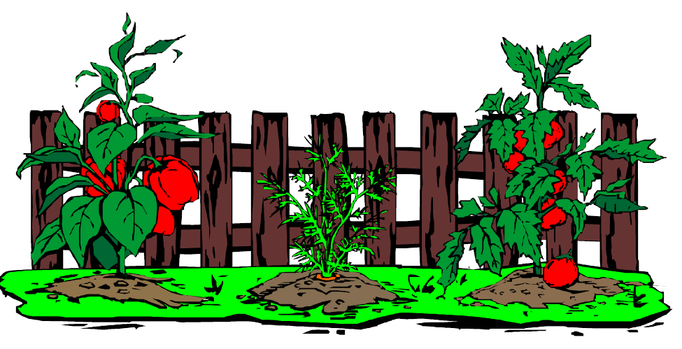
AHTA
Purpose: to advance the practice of horticulture as therapy for improving human well-being.
Mission: to promote and advance the profession of Horticultural Therapy as a therapeutic intervention and rehabilitative modality.

Slide 7
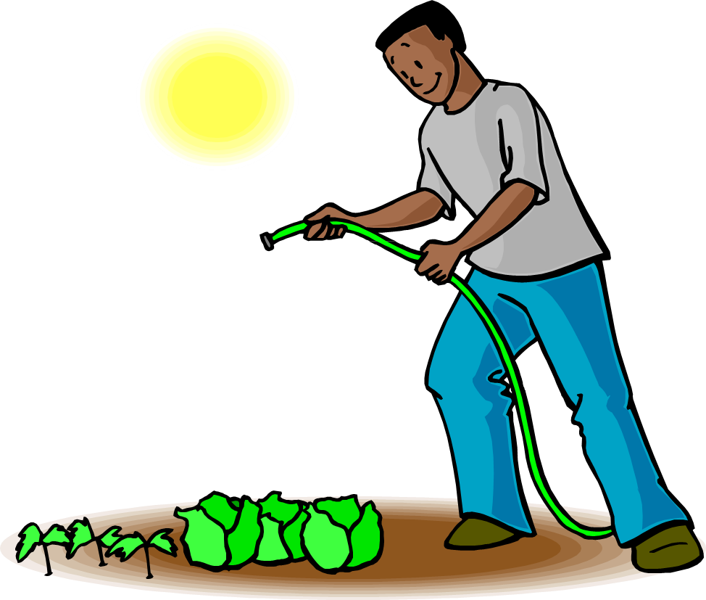
AHTA advances the profession:
By disseminating information
Encouraging professional growth
Establishing professional standards
Promoting research
Advocating for horticultural therapy
Promoting educational opportunities

Slide 8
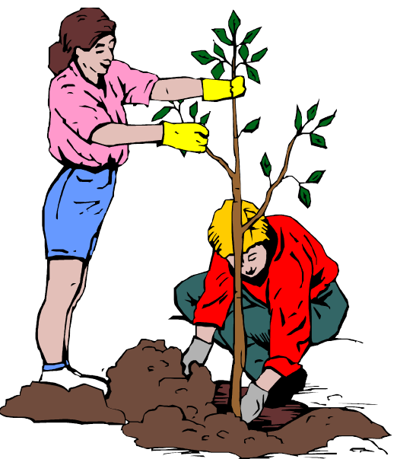
Who is a
Horticultural Therapist?

Slide 9
A Horticultural Therapist:
Has a minimum of a bachelor’s degree in horticultural therapy, or a bachelor’s degree with additional coursework in plant science, human science, and horticultural therapy.
Has completed a 480-hour internship in horticultural therapy.
Is professionally registered as a horticultural therapist with the AHTA as an HTR, Horticultural Therapist-Registered.

Slide 10
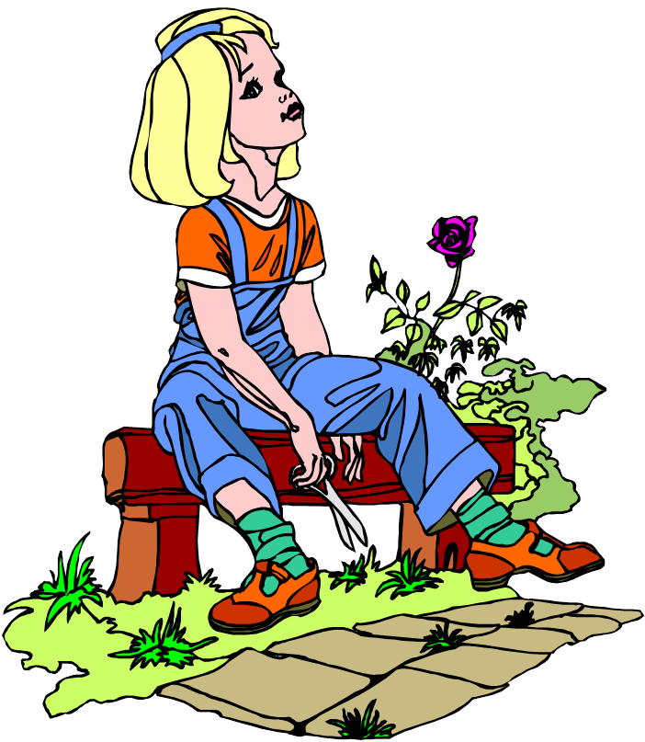
Where is
Horticultural Therapy
coursework
offered?

Slide 11

Colleges and Universities
Kansas State University
Nazareth College of Rochester
Rutgers, The State University of New Jersey
Colorado State University
Portland Community College
Oregon State University
Oklahoma State University
University of Tennessee

Slide 12

AHTA Accredited
Certificate Programs
Horticultural Therapy Institute – Denver, CO
Legacy Health Systems – Portland, OR
New York Botanical Garden – New York, NY
Rutgers University – New Brunswick, NJ
Temple University – Ambler, PA
Delaware Valley University – Doylestown, PA
Notes:
12

Slide 13
What is
Professional Registration?
HTR

Slide 14

Professional Registration
Professional registration is:
A voluntary process
Awarded after the completion of education
and training requirements
The professional designation of
Horticultural Therapist –
Registered, HTR

Slide 15
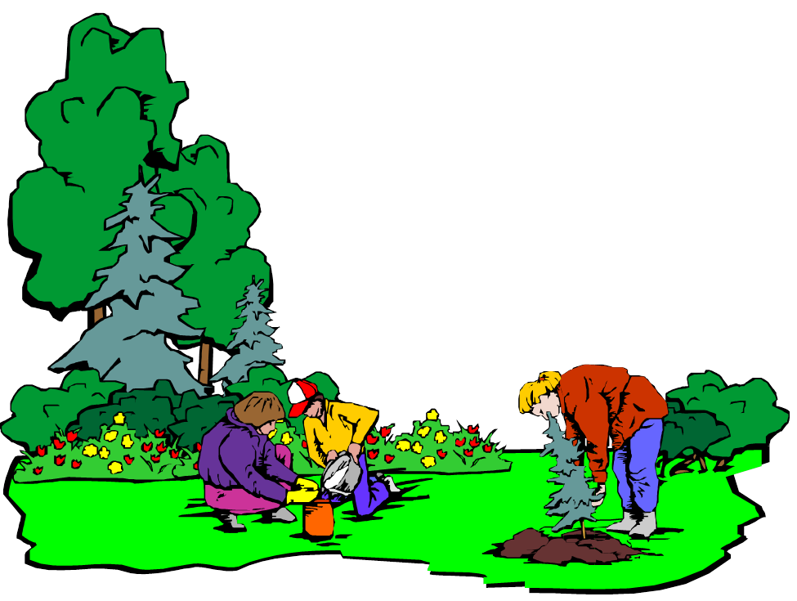
Is Professional Registration important?
Professional registration ensures that an individual has met the required education and training necessary to be a horticultural therapist.

Slide 16
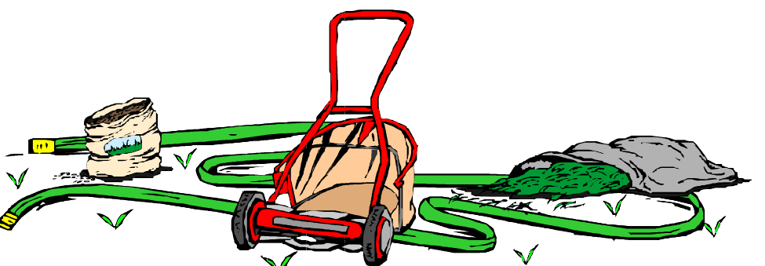
What is a
Horticultural Therapy Internship?

Slide 17
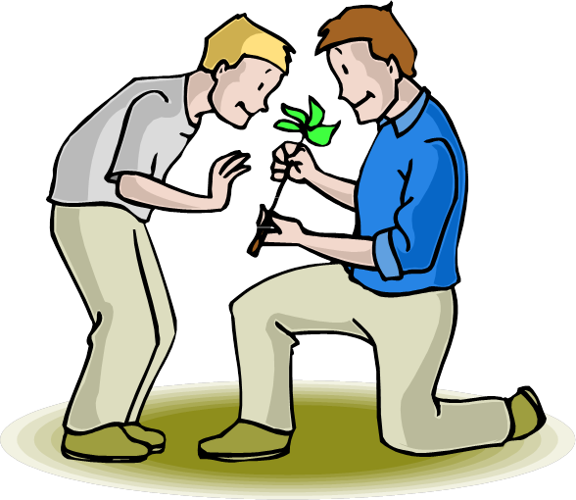
An internship is:
Supervised by a Registered Horticultural Therapist, HTR or HTM.
A combination of clinical and horticulture experience – 480 hours total.
Designed to provide experience
working with individuals of
all abilities.

Slide 18

Where does a
Horticultural Therapist work?

Slide 19

Horticultural Therapists work in:
Hospitals and Medical Centers
Rehabilitation Centers
Vocational Programs
Botanical Gardens
Schools
Residential Facilities
Correctional Facilities

Slide 20
For more information contact:
The American Horticultural Therapy Association
www.ahta.org

